Slide 1

360-Degree Photography
Senior Design 2018-19
Notes:
Presentation of the Award (“Token of Appreciation”) to Client. Thank client for the project, the opportunity, and all their efforts. Invite your client to speak.
Both

Slide 2
Company
E-commerce company headquartered in Lincoln
Located on Innovation Campus
Recently relaunched spreetail.com
Wanted to stand out from competition in terms of product presentation quality
Notes:
Give a synopsis of the company at a high level. Introduce the problem your project solved at a high level.
Anthony

Slide 3


Stakeholders
Ryan Gallus
Product Manager
Day-to-day sponsor
Taylor Kohl
Head of Product
Executive Sponsor
Notes:
Talk about the client and all the stakeholders involved in the project, including the product owner but also the other stakeholders that contributed to your project from the client side.
Jared

Slide 4
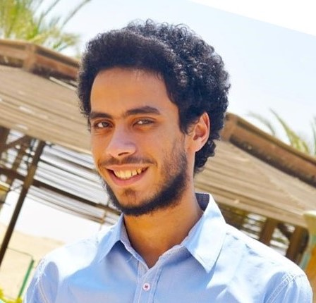
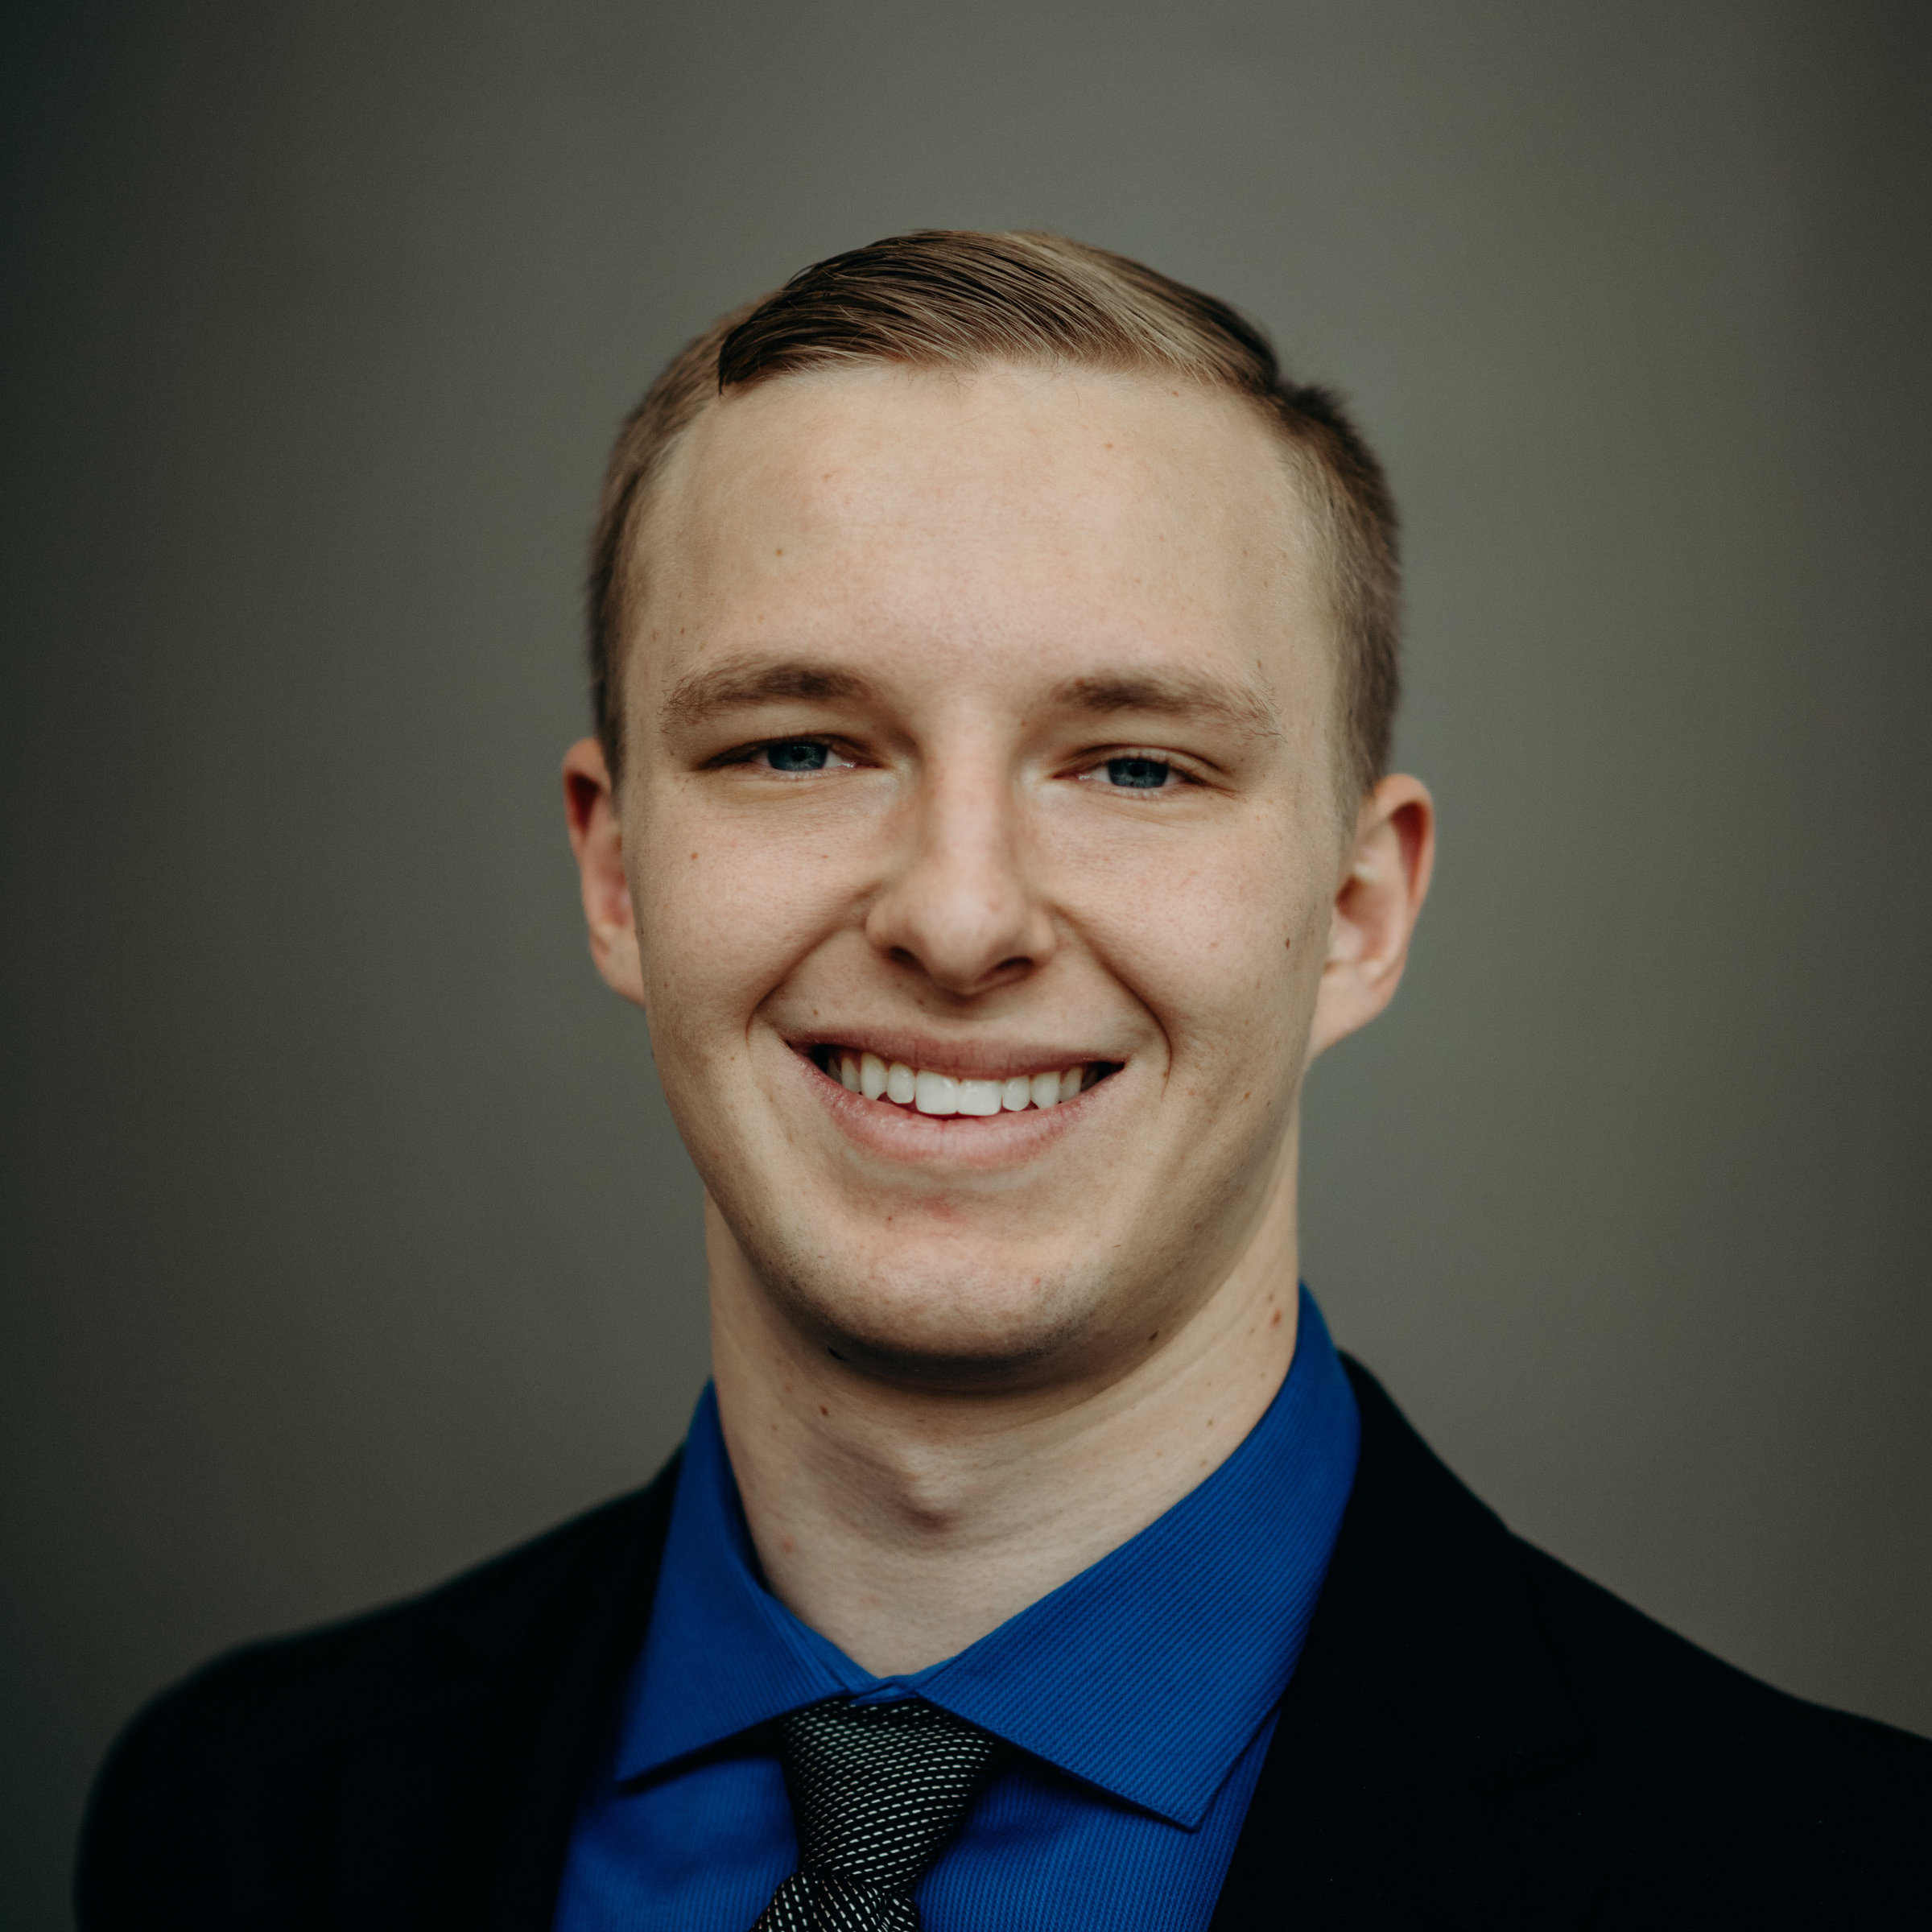
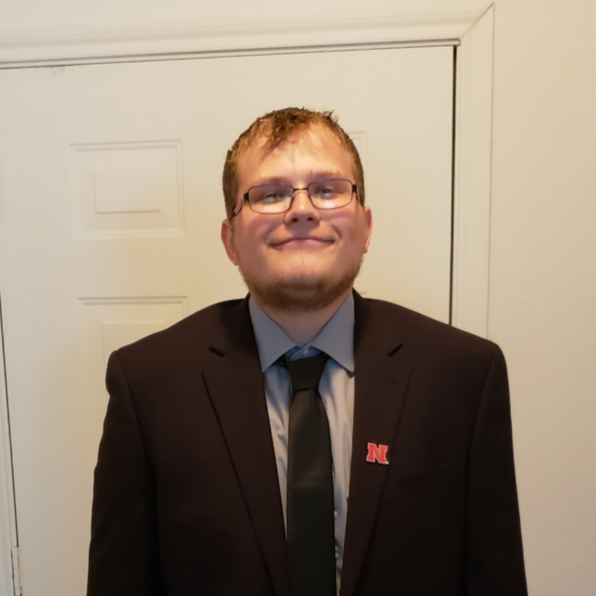
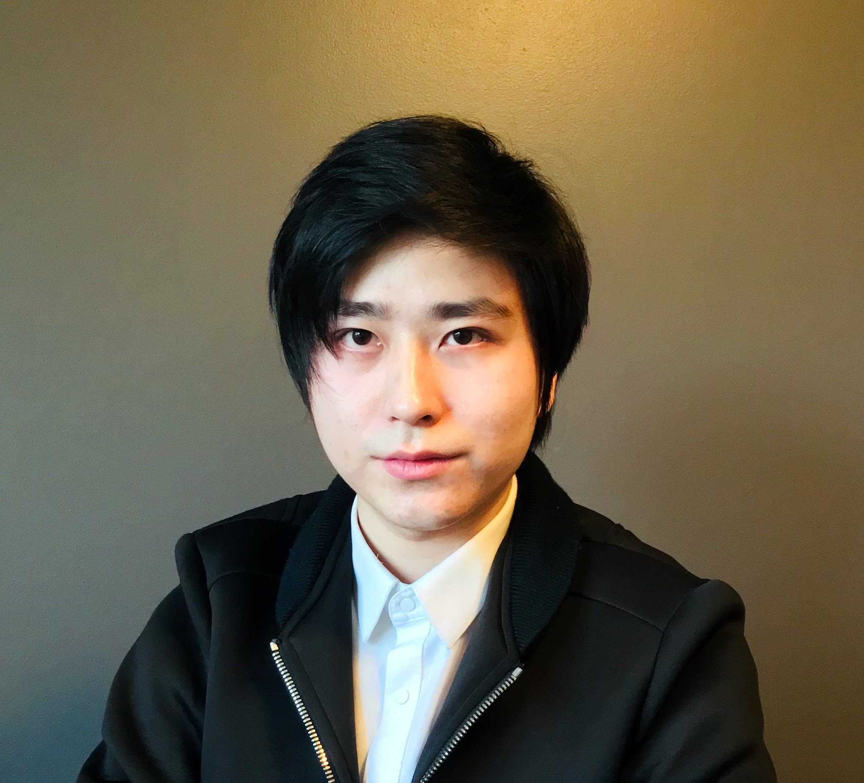
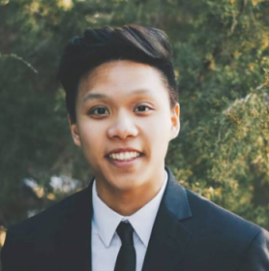
Senior Design Team
Taher Ahmed
Product Manager,
Squad Lead
Jared Nightingale
Development Manager
Brett Middle
Backend Developer
HaoZhou Li
Backend Developer
Anthony Tran
Frontend Developer
Notes:
Explain your team organization. List your team members, with their squad roles (i.e. product owner from the client side, squad lead, product manager, development manager, developers, coach, tribe lead, project manager, etc.)
Anthony

Slide 5


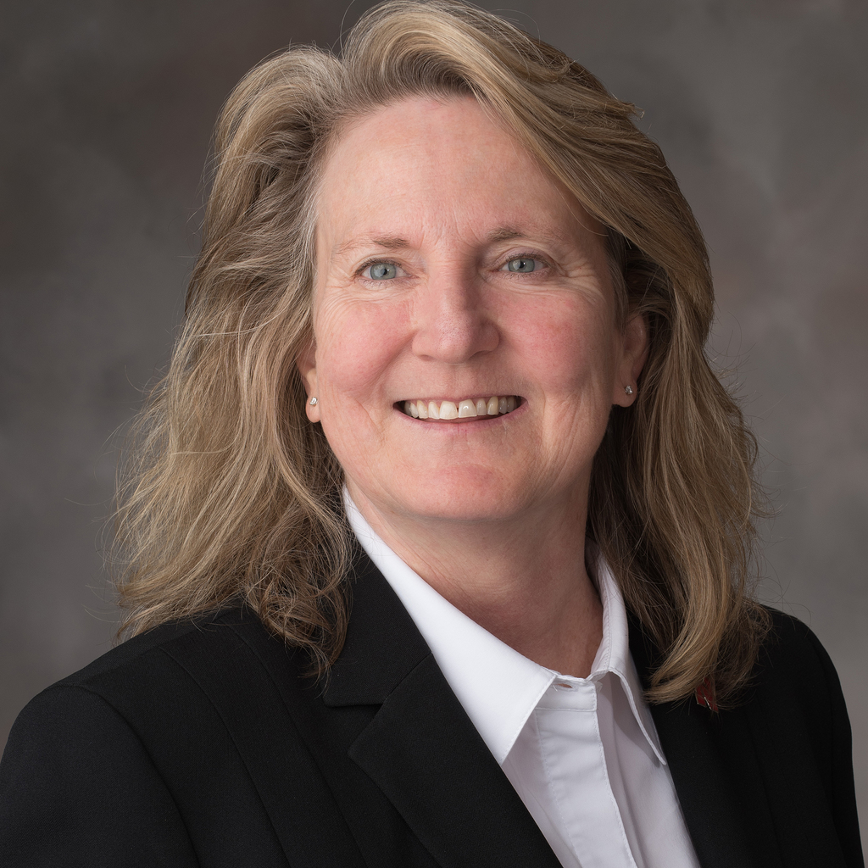
Senior Design Staff / Faculty
Matt Kirilov
Coach
Stephen Reichenbach
Tribe Lead
Melanie Kugler-Wright
Project Manager
Notes:
Explain your team organization. List your team members, with their squad roles (i.e. product owner from the client side, squad lead, product manager, development manager, developers, coach, tribe lead, project manager, etc.)
Jared

Slide 6
Problem and Opportunity
Spreetail wants a new style of product presentation
Upcoming (now live) e-commerce website
Current photography process is time-consuming
Customers 60% more likely to buy product with good photography
Idea
Add a 360-degree product view to product listings
Solution
Create a hardware and software solution to provide consistent, high quality images of a product rotating on an electric turntable.
Notes:
Review the problem the client provided for your team to solve. Explain the opportunities your product provides to solve the client’s problem.
Anthony

Slide 7
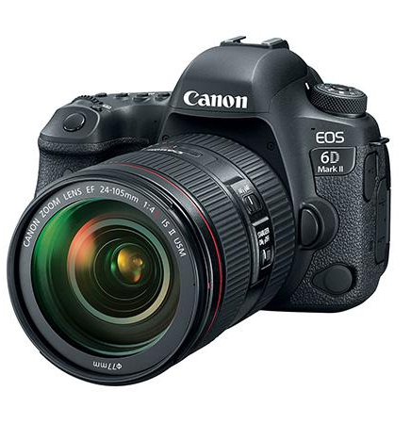
Solution
Hardware & software solution
User friendly front-end
View and select images to save
2 DSLR cameras
Electric Turntable
Computer tower
Software to control cameras
Communicates with front end
Notes:
Examine the value of the solution created for the client. Give some of the highlights of the project including project results and the substantial learning opportunities your team was provided by the client.
Jared

Slide 8
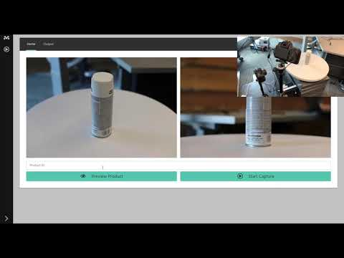
Notes:
Anthony

Slide 9
Value and Highlights
Spreetail
Photography process mostly automated
User required to change camera angles
Review photo quality
Lasts approximately 107 seconds
User can grab another product as the process runs
Capture around 70 photos (per camera) in 1 rotation
Two-click upload to Spreetail’s Microsoft Azure Storage
Upload in the background
User can start taking images of a new product during upload
Fast, simple, and efficient photography process
Notes:
Examine the value of the solution created for the client. Give some of the highlights of the project including project results and the substantial learning opportunities your team was provided by the client.
Jared

Slide 10
Value and Highlights
Senior Design Team
Started as vague idea with a slight direction
Freedom of creativity
Work in a team environment
Learn to deal with project struggles
Work with some of Azure’s many services
Learned new programming languages
Notes:
Examine the value of the solution created for the client. Give some of the highlights of the project including project results and the substantial learning opportunities your team was provided by the client.
Anthony

Slide 11
360-Degree Photography
Senior Design 2018-19
Notes:
Presentation of the Award (“Token of Appreciation”) to Client. Thank client for the project, the opportunity, and all their efforts. Invite your client to speak.
Both?

